Slide 1
Analyzing Proteins from a Tyrannosaurus rex

Slide 2
Today’s Goal
Learn how a mass spectrometer can be used to identify the types of protein in a biological sample.
Learn how proteins are analyzed from a dinosaur fossil.
Be able to analyze protein mass spectra and to compare two mass spectra in order to identify an unknown protein fragment.

Slide 3
Getting ready for the activity
The three extinct animals we will discuss: T. rex, mastodon, hadrosaur
What is a Mass Spectrometer?
What are spectra?
What is the central dogma?
How is DNA used to learn more about evolution?

Slide 4
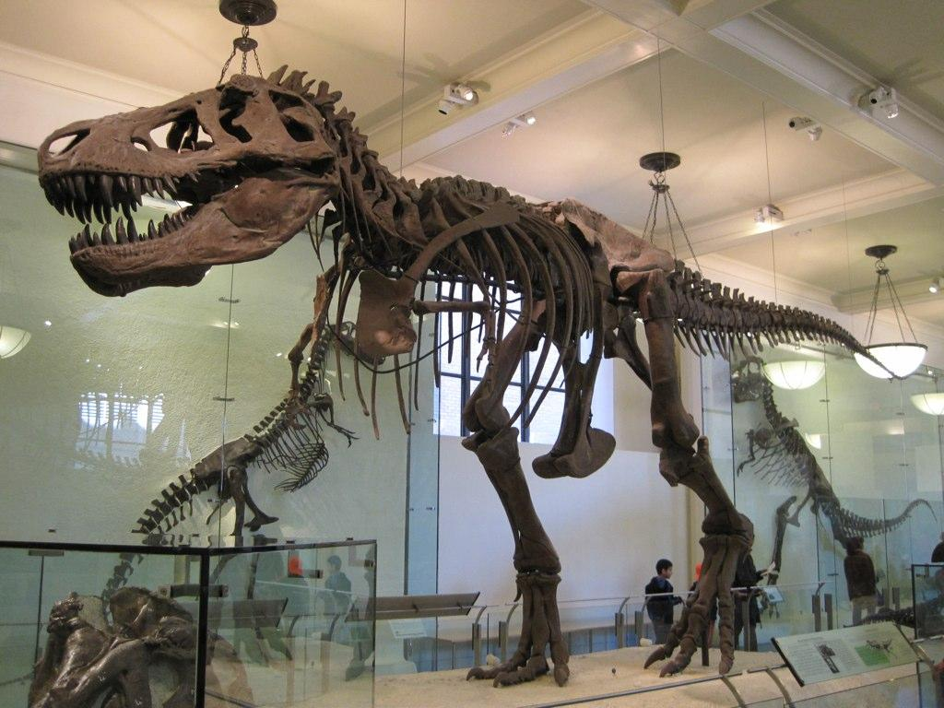
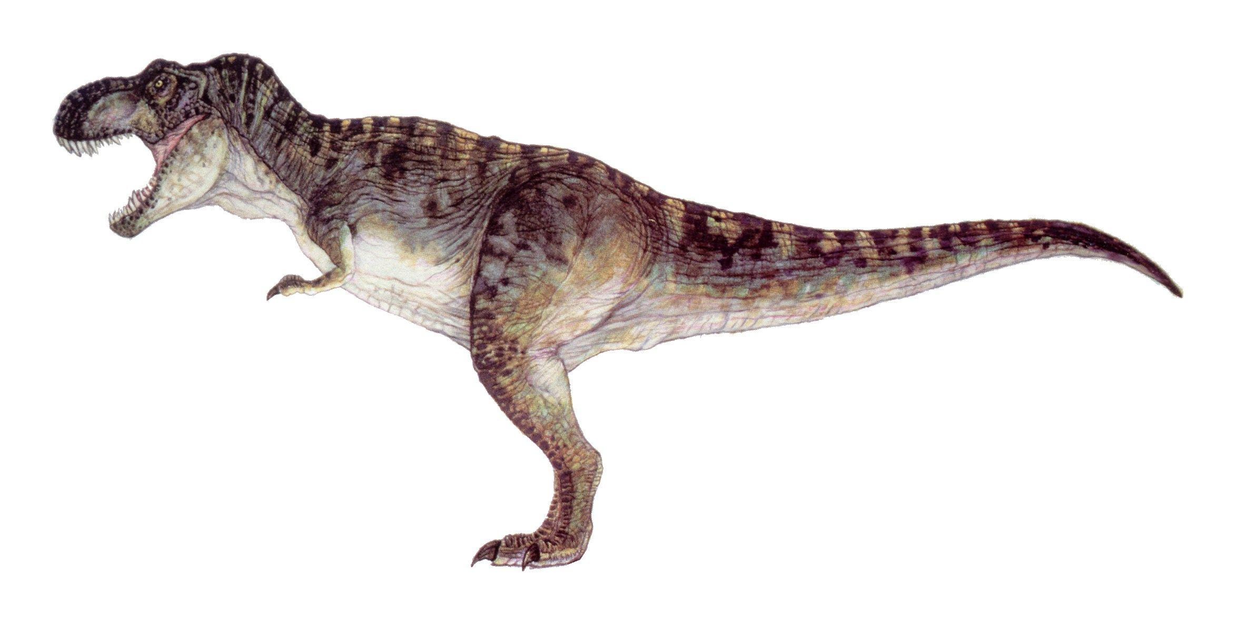
Tyrannosaurus rex
65 to 70 million years ago the Tyrannosaurus rex dominated the land in western portion of the US. They once stood 12 feet tall, and 40 feet long, and is one of the largest carnivores to ever live on Earth. Sadly, they were also among the last of the large dinosaurs left.

Slide 5
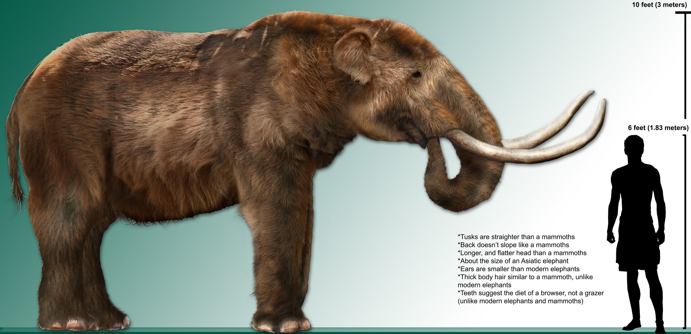
Mastodon
The Mastodon (Mammut americanum) is an extinct mammal, closely related to the woolly mammoths. They lived in North and Central America roughly 10,000 years to 13 million years ago. In today’s activity you will only be working with a T-rex fossil, however, the Mastodon will come up in future activities.

Slide 6
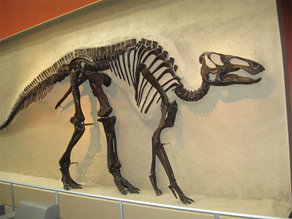
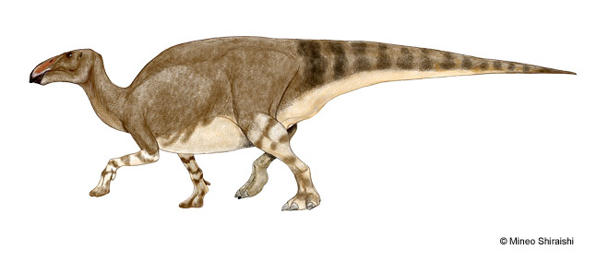
Hadrosaur
Hadrosaurs were a family of common herbivorous dinosaur species that lived 65–75 million years ago. They are known as the “duck-billed” dinosaurs since the bones that make up their snout resemble the bill of a duck. Their “bill” was well adapted for ripping off plants. Hadrosaurs ranged in size from 10 to 65 feet long, and could have possibly been able to outrun a T. rex.

Slide 7
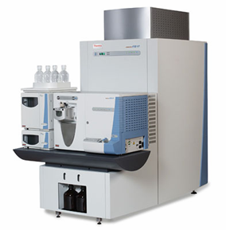
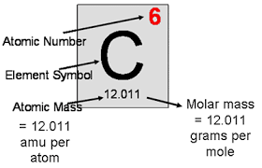
Mass Spectrometer
Each chemical element has a specific number of protons and electrons, for example, a carbon atom normally has six protons and six electrons.
If a carbon atom loses or gains an electron it changes the charge of the atom, making it an ion. If carbon loses one electron, it becomes a carbon ion with a +1 charge.
A mass spectrometer (above left) is an instrument that can fragment a protein (from a complex sample) into ions, and determine precisely what molecules and compounds are found in the sample. It does this by analyzing, for each ion, the ratio of the ion’s mass (m) to its charge (Z), i.e., the ratio m/Z.
In mass spectrometry, it is common to call a protein fragment a “peptide”.

Slide 8
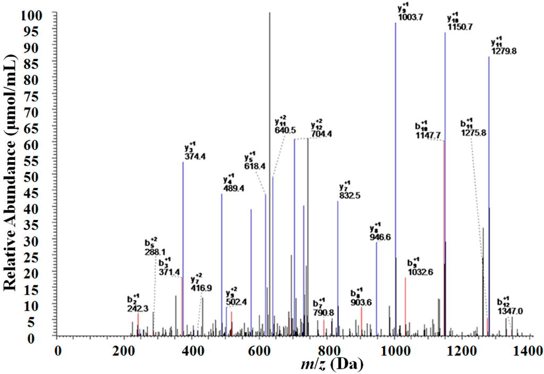
Spectra
After putting a sample into the spectrometer, it provides the results as a spectra.
Using the spectra, scientists can determine which elements are present, how much of each elements are present, and what the substance is if it was unknown.
We will be using the spectrometer to determine what genetic material is locked inside the fossil of a T-rex. Once it provides us the resulting spectra, we can compare it to known spectra in order to identify it. This is typically done using a large computer database.

Slide 9
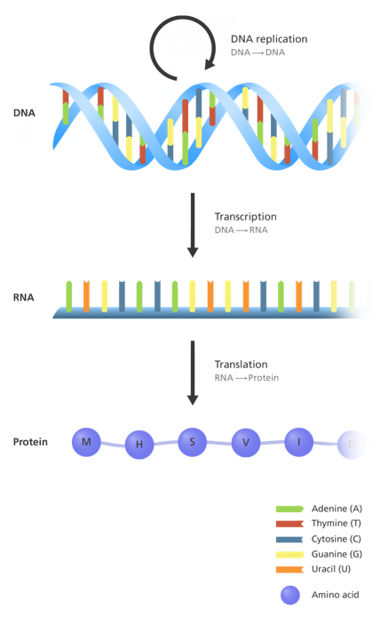
Central Dogma: DNA to RNA
DNA
In order to understand a protein mass spectrum, it is important to know the three main types of biological molecules: DNA, RNA, and proteins.
DNA contains all of an organism's genetic information coded in four letters (A, C, G, T). The process by which cells convert the information from DNA into functional proteins is called the central dogma of biology.
In the first step of the central dogma, DNA is copied into RNA, which also has a four-letter alphabet (A, C, G, U). Next, based on the RNA sequence which acts as an instruction sheet, the cell makes a chain of amino acids (which has a 20-letter alphabet). After some additional processing by the cell, the amino acid chain becomes a functional protein.
RNA
Amino acid sequence
(becomes protein)

Slide 10
Here is a video showing the process of the central dogma.
This video includes some information is that not necessary to know for this activity, like RNA splicing.
However, it does do a good job at visualizing what is really going on during this process.

Slide 11
Molecular Evolution
Using DNA to understand how species evolve can be a confusing topic to understand. This video briefly covers what DNA is and how important it is in evolution.

Slide 12
Activity 2
Now that you have a basic background on these topics you may start Activity 2. Please open the PDF labeled “PDF for students Activity 2” and get started!

