Slide 1
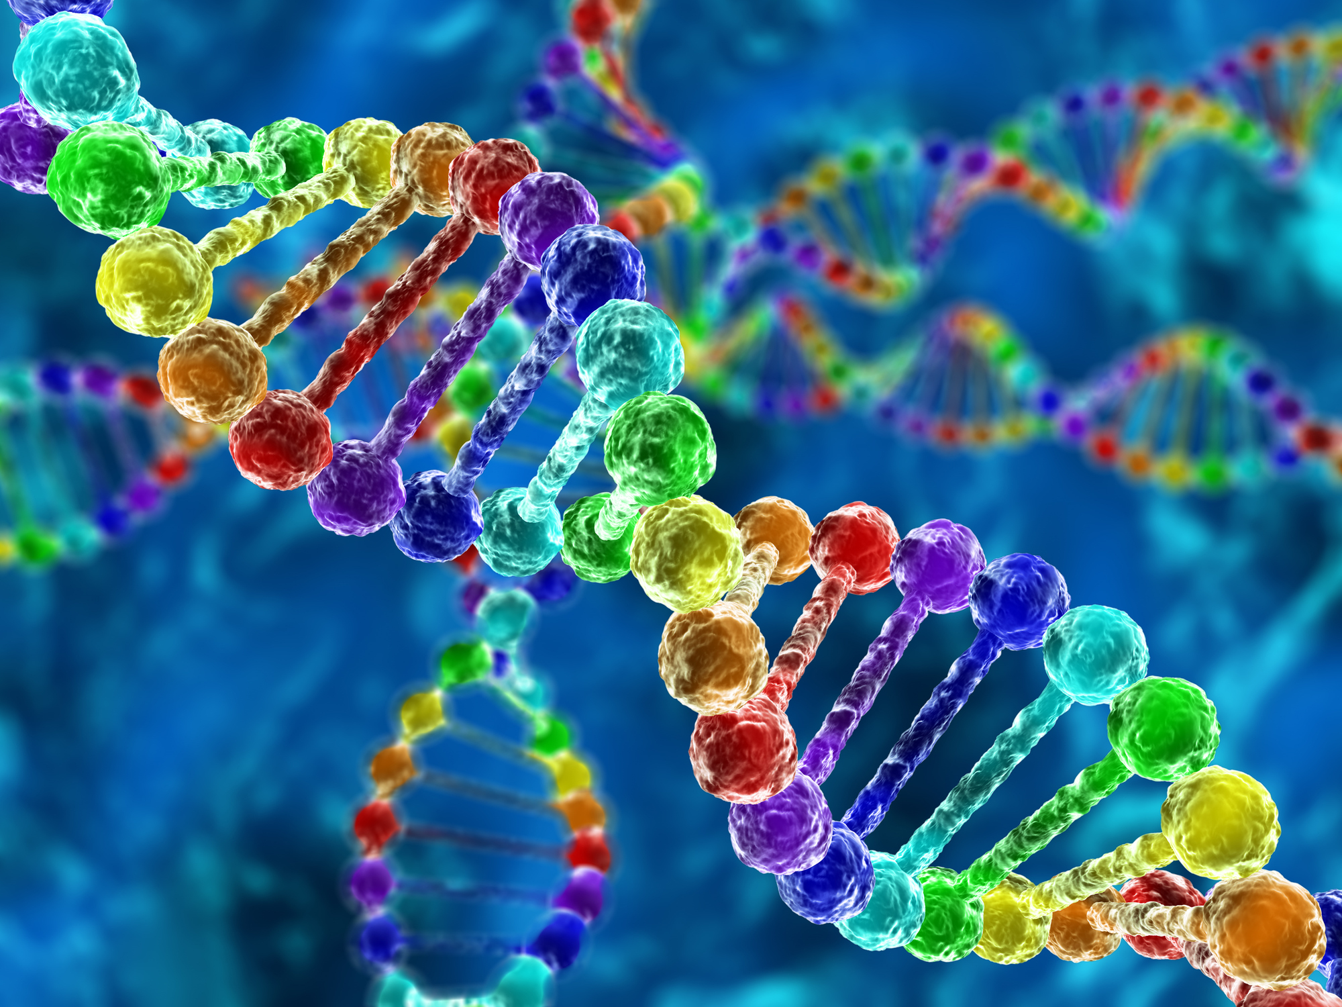
Traits BINGO (University of Utah)
STWS
Dominique Brooks, PhD

Slide 2
U of Utah: Genetics Science Learning Center

Slide 3
Traits BINGO
What’s about to happen?!
Intro/ Lead-In Discussion
BINGO
Setup
Play
Follow-up Ideas

Slide 4
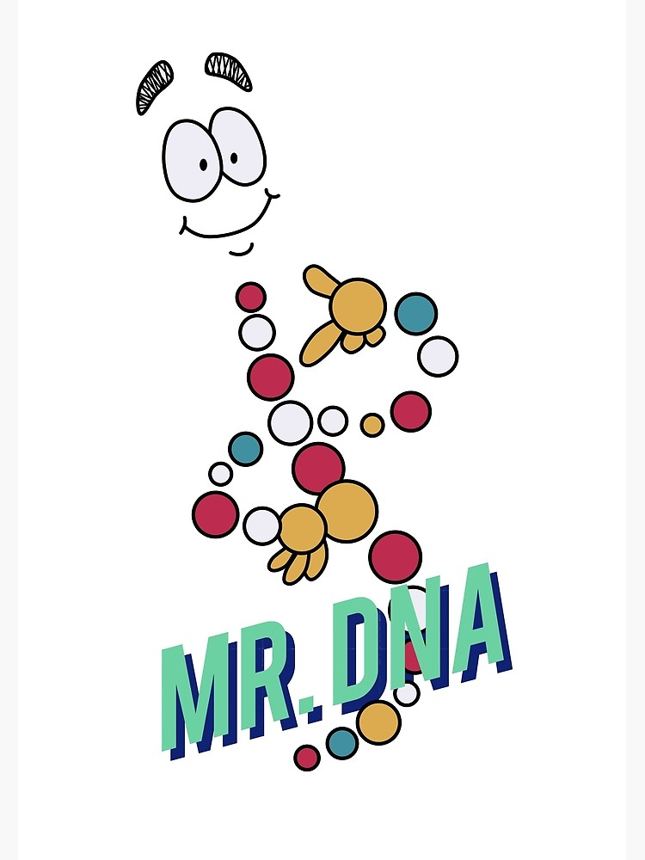
Introduction
The purpose of this activity is to help start the conversation on genetics and heredity. It focuses on external, observable traits.
Lead-In Discussion Ideas
What are traits?
What are genes?
Where do your genes come from?
Touch on traits from the list without explicit attention to them.
Ask about fun/favorite/unique traits.
* Ask about student generated ideas for Step 1.

Slide 5
BINGO!!
Setup and Gameplay

Slide 6
BINGO!!
Step 1: Create Game Board
Create a list of a combination of relationships (e.g. parent, aunt, sibling) and traits (see provided BINGO sheets for some examples).
You should have a total at least 24 traits and relationships, combined.
Feel free to make more for variability.
Have the students submit traits.
You create the entire list.
Optional: PTC
Have the students construct a BINGO board using the traits and relationships and a FREE space.
Students can use words and/or pictures.
Student can use items or cut up bits to mark off their board if they want to reuse them.

Slide 7
BINGO!!
Step 2: Game Play
Use the “BINGO QUESTIONS” sheet to run though as many rounds as you choose!
Traditional, 4-corners, blackout
Use your own prompts and follow-ups

Slide 8
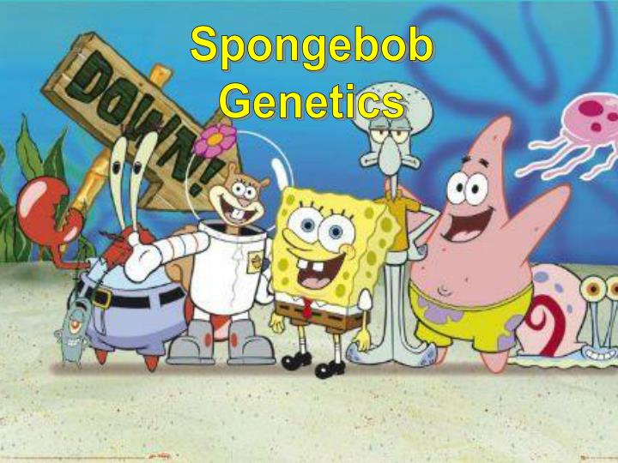
Continuing Genetics
More ways to play and additional activities!!
Play with your family and friends!
Answer based on someone else!
Discover new traits and make new boards!
Try these activities that can be found at:
https://smile.oregonstate.edu/summer-2019-teacher-workshop under Elementary – Genetics.
SpongeBob Genetics
Alien Genetics

Slide 9
Thank You!
Precollege Programs
Questions or comments?
Contact: SMILEprogram@oregonstate.edu

