Slide 1
PTC: Can you taste it?
A learning activity for Mendelian genetics
Notes:
You can find our notes at the bottom of each slide.
This is the slide to introduce the activity without revealing any significant details.

Slide 2
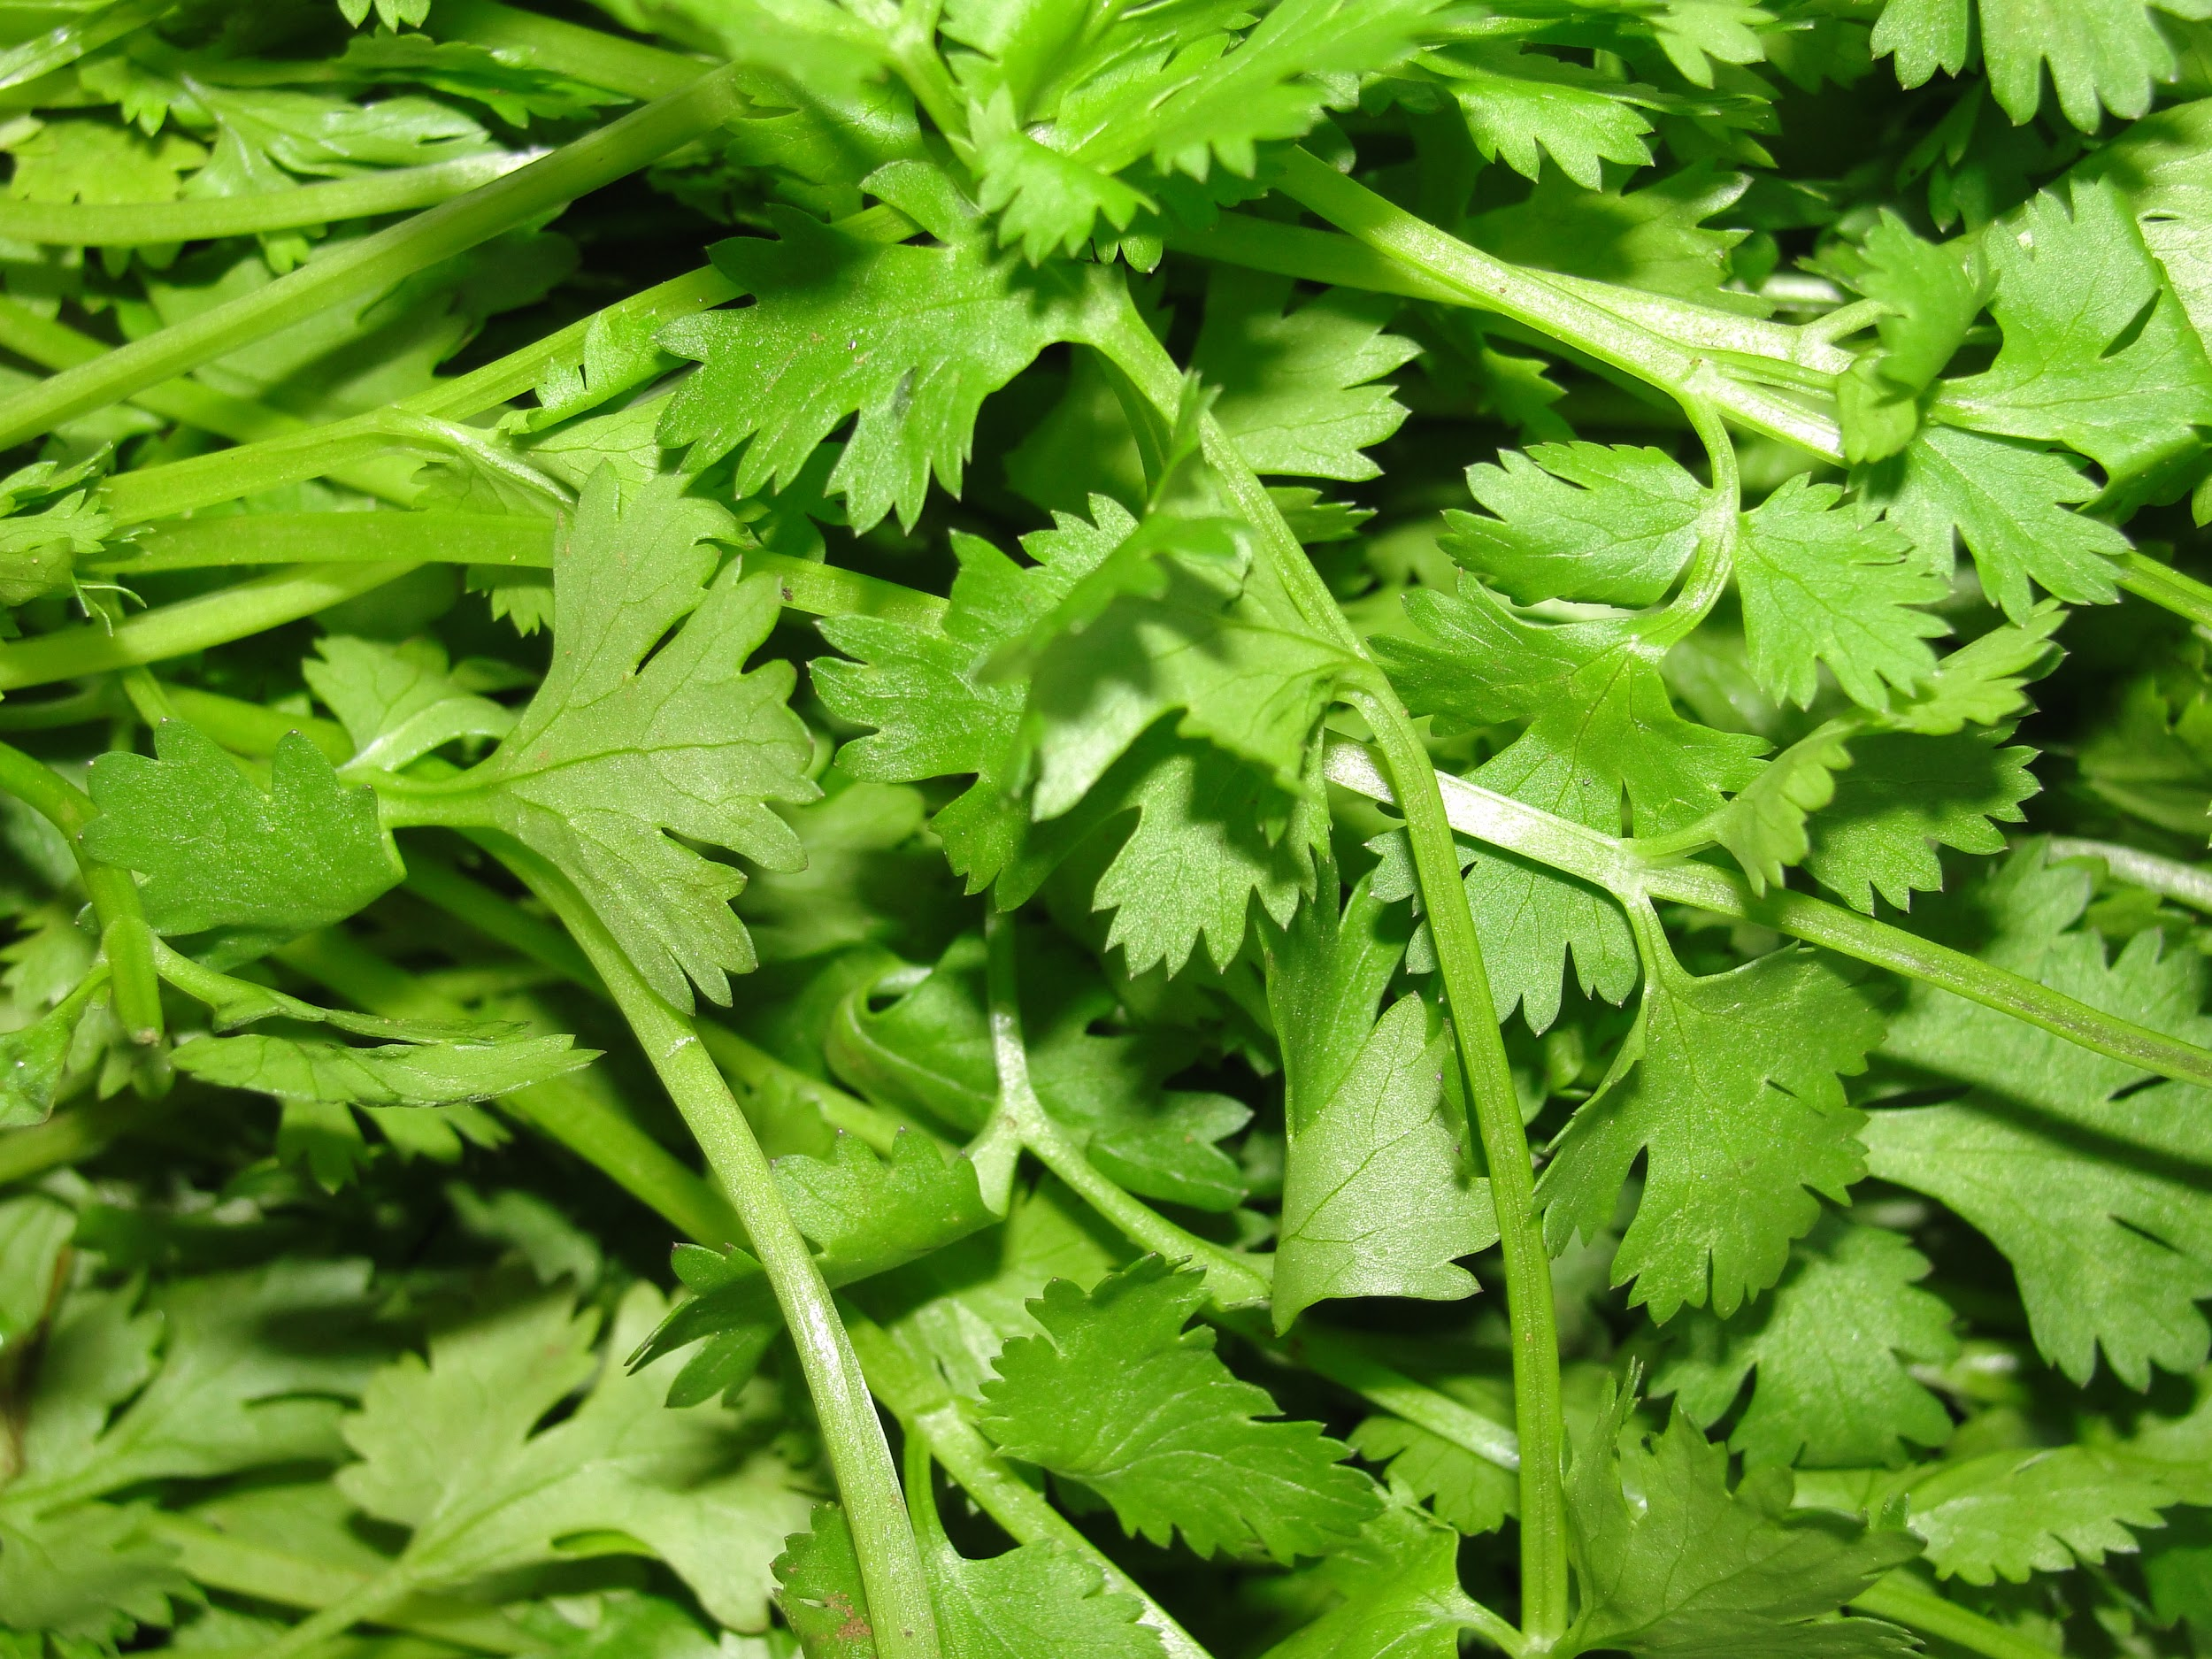
Do you like the taste of cilantro?
Notes:
Ask the classroom if they like the taste of cilantro. Call on about three students and then say that this activity will give insight to why they may or may not like the taste of it.

Slide 3
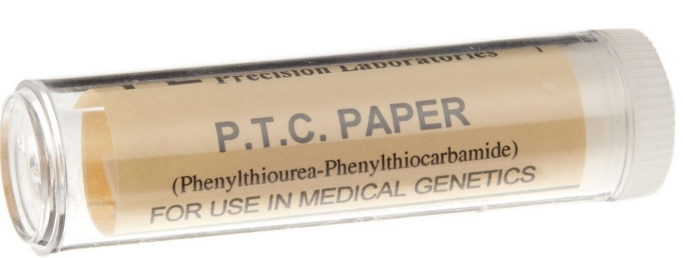
Materials that you will need for this activity
-One strip of paper infused with Phenylthiocarbamide (PTC)
-One strip of “control paper” that is not infused with PTC
-A sheet of paper and a pencil to record your observations
Notes:
Hand out one strip of regular paper and one strip of the paper infused with PTC. This is not a harmful dose of PTC just in case anyone has any concerns! The control paper is created by the same company that provided the PTC strips.
We suggest having a whiteboard, document camera, smartboard, etc. to record the classroom’s results where they can all see them.
Source of photo:
https://msanader23.files.wordpress.com/2015/03/ptc-paper.jpg

Slide 4
Instructions
Label your control strip of paper “#1”
Label your PTC-infused strip of paper “#2”
Put strip #1 against your tongue and write down what it tastes like.
Put strip #2 against your tongue and write down what it tastes like.
Notes:
This slide is self explanatory for the students. After they have finished tasting the paper, have candy or water available to those who are “super-tasters”.

Slide 5
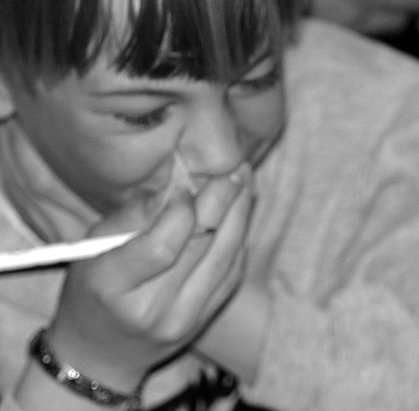
What did strip #2 taste like?
-Raise your hand if you could taste anything on strip #2
-Describe the taste to the rest of the classroom.
Was it intense? Not so much?
Notes:
This is where you should write down the fractions of tasters and non-tasters on a board that is visible to all of the students. We will be assuming that anyone who can taste PTC is either a homozygote for the “taster” allele or a heterozygote.
Ask those who can taste the PTC to describe it. Was it unbearable? Bitter?
Photo source:
http://learn.genetics.utah.edu/content/inheritance/ptc/images/DSC00100.jpg

Slide 6
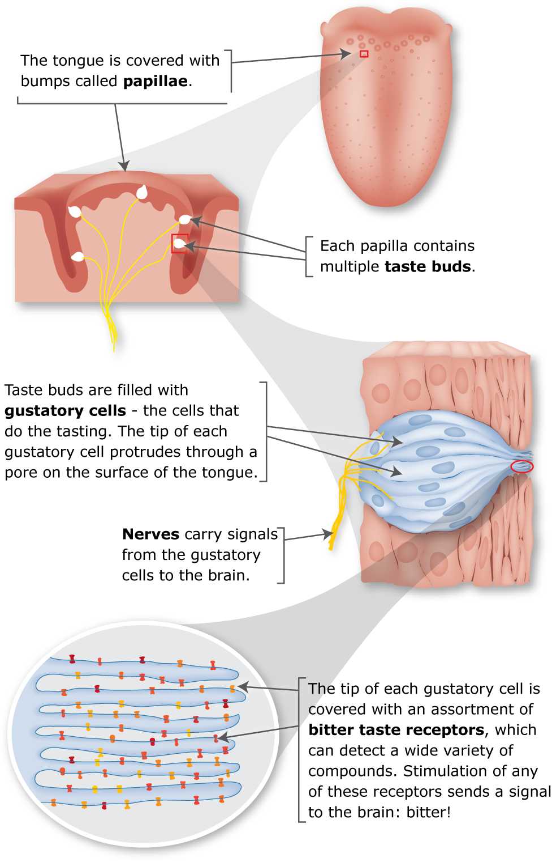
Why can some students taste it while others cannot?
-Because there is a single gene (TAS2R38) which codes for the taste receptor protein TAS2R38 that is expressed in your tongue. PTC will bind with the receptor if the TAS2R38 gene has the “taster” allele, but if neither of your two “copies” of the TAS2R38 gene has the “taster” allele, your taste response will not register a bitter taste from PTC.
Notes:
Before continuing to the large paragraph, have the students think about why some people could taste while others cannot. Call on a couple students and see what they think. If they are stuck, give them some hints.
Give hints towards genetics:
-Think taste buds on tongues
-Think natural selection
Photo source:
http://learn.genetics.utah.edu/content/inheritance/ptc/images/DSC00100.jpg

Slide 7
Example Punnett Square
TT = homozygous dominant are “tasters”
Tt = heterozygous are “tasters”
tt = homozygous recessive are “non-tasters”
 | Paternal T | t
Maternal T
t
Notes:
Have students fill in the Punnett Square in a way you choose (as a class or in groups).
Uppercase T represents: TAS2R38 “taster” allele
Lowercase t represents: TAS2R38 “non-taster” allele
There is a ¾ chance that the offspring will have at least one taster allele and a ¼ of having two non-taster alleles.
Correct Answer:
TT Tt
Tt tt

Slide 8
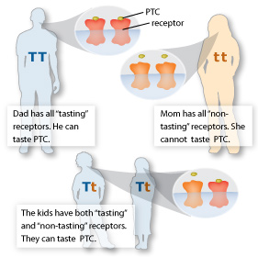
Look at the proportion of those who can taste PTC
-Which is more prevalent? Being able to taste the PTC or not?
-Is the genetic ability to taste PTC dominant or Recessive?
-What percentage of the population do you think can taste PTC?
Notes:
Point everyone’s attention to the board where you wrote down the fractions of tasters and non-tasters. Have them think about the statistics. Which is more prevalent? Does this necessarily make it dominant or recessive? Have them think of sample size (i.e., the number of students whose phenotypes were recorded in this activity) as well! Then with this information, have them make a prediction about the percentage of the population that can taste PTC.
Keep in mind that the classroom could potentially have more non-tasters than tasters, which is not true to the population statistic. Feel free to bring that up to the students and note that sample size is a huge factor in creating persuasive statistics.
Photo Source:
http://learn.genetics.utah.edu/content/inheritance/ptc/images/Pedigree.jpg

Slide 9
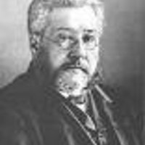
History
In 1931, chemist Arthur Fox was handling a bottle of Phenylthiocarbamide (PTC). When some of it was accidentally released into the air, a colleague of his complained of a bitter taste in his mouth, while Fox tasted nothing. After this incident, Fox had friends and family taste the chemical and asked them to describe the taste. Some found it intensely bitter, others only slightly bitter, and reported no taste at all.
Notes:
Once you have finished discussing the fractions of tasters and non-tasters, and whether being able to taste PTC is dominant or recessive, reveal the history behind PTC.
Photo Source
https://0.academia-photos.com/321416/134576/156544/s200_arthur.fox.jpg

Slide 10
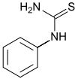
Background
About 70% of the population can taste PTC. It is an autosomal dominant trait. This taster percentage is higher among indigenous people of the Americas, and lower for indigenous people of Australia and New Guinea. Some studies have shown that those that can taste PTC are less likely to smoke or drink coffee. PTC is not present in food, but related chemicals are. The ability to taste the bitterness is caused by a polymorphism at the TAS2R38 taste receptor gene.
Notes:
Here you can discuss whether the class's prediction of the population frequency, for ability to taste PTC, was accurate or not. Add that trait is autosomal dominant. “Autosomal,” means the gene is not on a sex chromosome, but rather, on an autosome.
In the attached chemical diagram, unlabeled vertices are carbon atoms, and the carbon atoms on the “ring” (except the nitrogen-bound carbon atom) are bound to hydrogen atoms.
Photo Sources:
https://en.wikipedia.org/wiki/Phenylthiocarbamide

Slide 11
Discussion
-If two parents are heterozygotes for the gene that allows for them to taste PTC, what is the probability that their child will also be able to taste it? (Hint: do a Punnett square)
-Over recent evolutionary time, do you think the proportion of the PTC taster allele is expanding in the population, or decreasing? Why? (hint: is it an advantage?)
Notes:
1. If both parents are heterozygotes (each has on taster allele and one non-taster allele), have the students set up a Punnett square. With two heterozygotes, there is a 25% of being homozygous dominant for the taster allele, 50% heterozygous, and 25% homozygous recessive for the taster allele. Thus, the child only has a 25% of NOT having the taster allele and 75% chance of having the taster allele.
2. This is up to the student's’ discretion. Point their minds in the direction of being able to taste poisonous plants and foods. Since foods are more processed and we don’t need to hunt, is there a need to able to taste bitter compounds?

Slide 12
Record the Class’s Results on this Google Sheet
goo.gl/0n1qlG
http://goo.gl/0n1qlGhttp://goo.gl/0n1qlG
http://goo.gl/0n1ql
Compare your class’s results with the other SMILE groups!
Notes:
Be sure to add your classroom’s results to this Google spreadsheet so all of the SMILE groups can compare!

Slide 13
References
Figure 1: https://msanader23.files.wordpress.com/2015/03/ptc-paper.jpg
Figure 2: http://learn.genetics.utah.edu/content/inheritance/ptc/images/DSC00100.jpg
Figure 3:http://learn.genetics.utah.edu/content/inheritance/ptc/images/Pedigree.jpg
Figure 4: http://learn.genetics.utah.edu/content/inheritance/ptc/images/DSC00100.jpg
Figure 5: https://0.academia-photos.com/321416/134576/156544/s200_arthur.fox.jpg
Figure 6:https://en.wikipedia.org/wiki/Phenylthiocarbamide
[1] “PTC: Genes and Bitter Taste.” [Online]. Available: http://learn.genetics.utah.edu/content/inheritance/ptc/. [Accessed: 19-Jul-2016].
Notes:
Thank you!
If you have any questions, please email genetic4.osu@gmail.com

