Slide 1
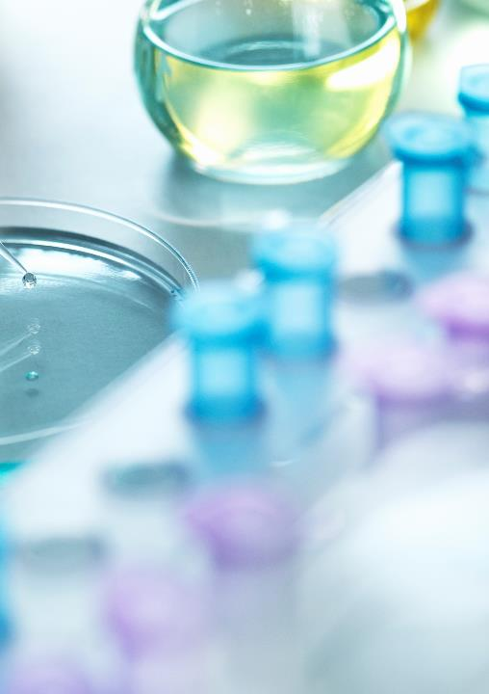
MIDDLE SCHOOL GENOMICS ACTIVITY
DOMINIQUE BROOKS
STEPHEN RAMSEY

Slide 2
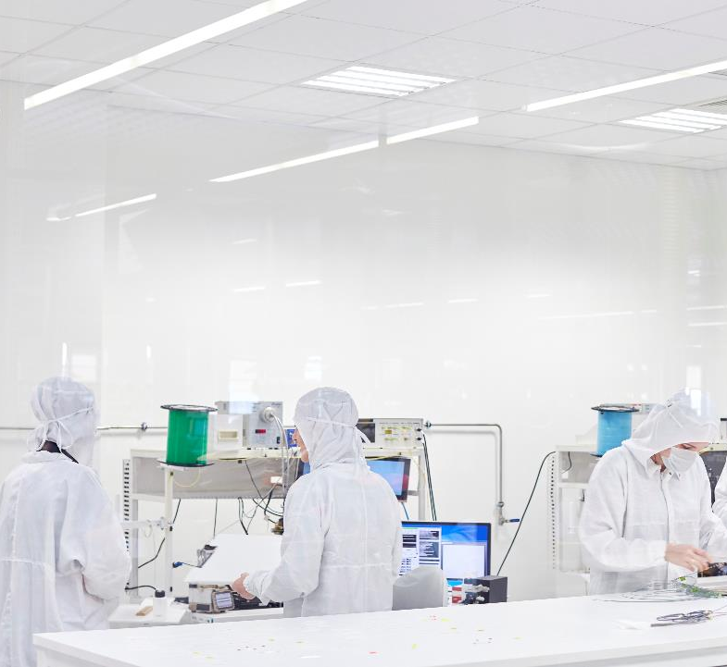
QUICK OVERVIEW
BACKGROUND
PROCEDURE: MURDER MYSTERY
DEBRIEF: RARE DISEASES

Slide 3
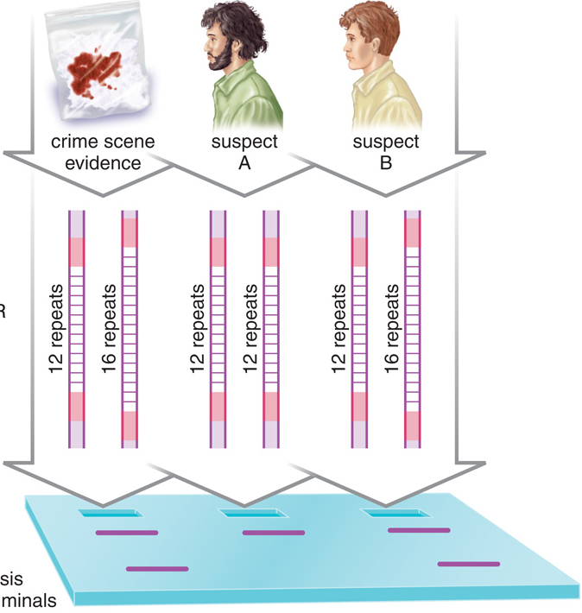
DNA profiling answers 6 types of questions
Do these two samples (blood, hair, skin cells, saliva, etc.) contain DNA from the same living thing (person, animal, plant, etc.)?
Does this sample have DNA from a person whose DNA fingerprint is already known to us?
Are these two samples from related individuals?
Does this sample have DNA from a person who is a relative of a person whose DNA fingerprint is already known to us?
What can we learn about the person/animal/plant from whom this sample was obtained?
Is the DNA in this sample a mixture from multiple donors? Which donors dominate in the mixture?
Notes:
The highlight is for the two questions relevant to the game that we will play today

Slide 4
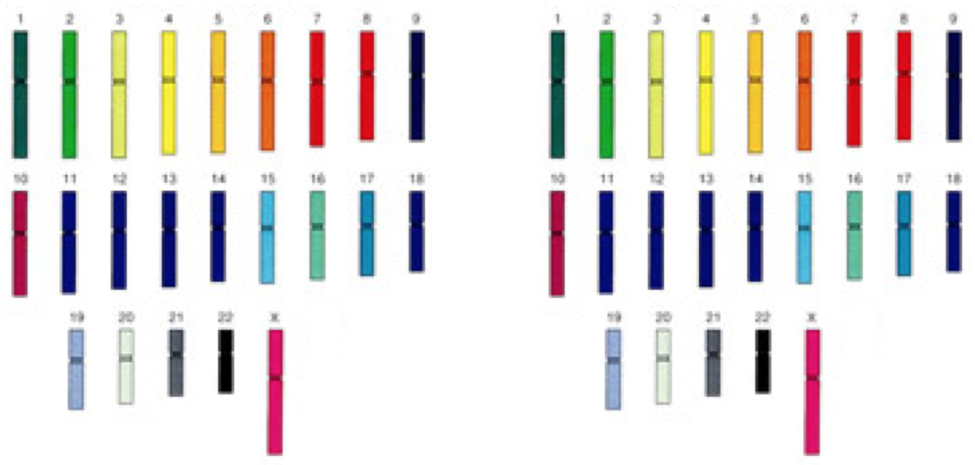
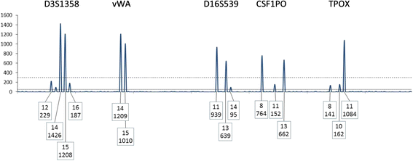
How to get from DNA sample to DNA profile?
?
DNA sample from “Alice”
(6 billion bases)
DNA profile
(~30 labeled peaks)

Slide 5
BACKGROUND : DNA FINGERPRINTING

Slide 6
A “locus” on a pair of Alice’s chromosomes
7
7
Locus “D7S820”
Locus “D7S820”

Slide 7
D7S820 contains a short region of DNA with the “GATA” sequence repeated
GATAGATAGATAGATAGATAGATA…
GATAGATAGATAGATAGATAGATA…
Locus “D7S820”
Locus “D7S820”
This kind of repetitive sequence is known as a variable-number tandem repeat, or VNTR.

Slide 8
There are about ten known lengths (alleles) for D7S820; Alice has two different alleles here
GATAGATAGATAGATAGATAGATA
Length = 24
GATAGATAGATAGATAGATAGATAGATA
Length = 30

Slide 9
The flanking sequence is not repetitive; thus we can copy out the alleles by PCR
Length = 24
Length = 30

Slide 10
The original chromosomes are diluted away, leaving DNA fragments of two sizes
We get two peaks on
the DNA size readout
D7S820
Length = 24
Length = 30
24
30

Slide 11
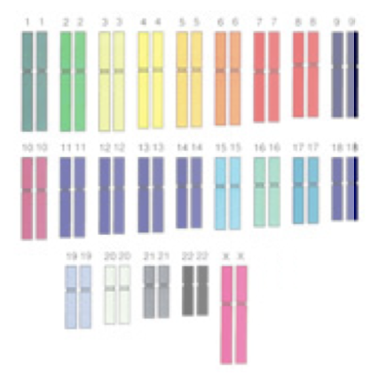
This procedure is performed for about 15 loci
Alice’s genome
Alice’s profile

Slide 12
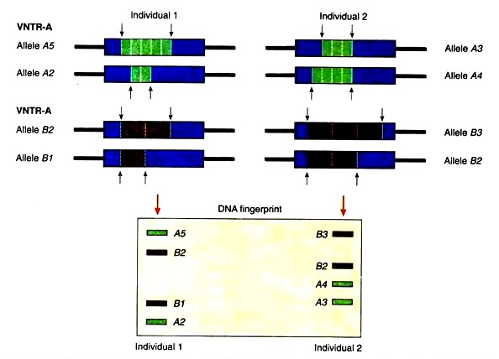
Consider Question 1: “Do these two samples contain DNA from the same person?”, with only two loci (to keep things simple)
B
Notes:
http://www.notesonzoology.com/dna/dna-fingerprinting/dna-fingerprinting-meaning-bases-and-its-applications/5368

Slide 13
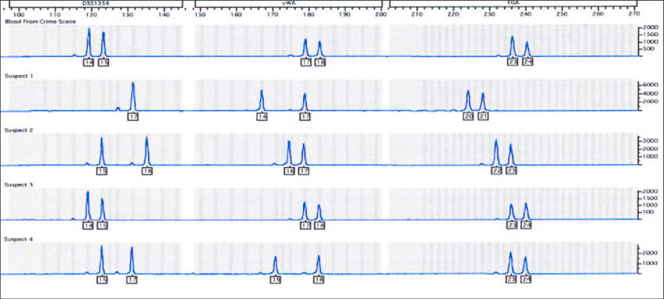
Question 1: screening several suspects
Suspect #3 DNA sample is a match to the crime scene sample

Slide 14
Question 2: Crime labs will search a sample’s DNA profile against a database of DNA profiles

Slide 15
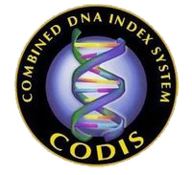
CODIS database
Run by the Federal Bureau of Investigations
National database of DNA profiles of offenders or felony arrestees
Has about 17 million DNA profiles in it (mostly from offenders)
CODIS loci selected so they will not be informative as for physical characteristics or race

Slide 16
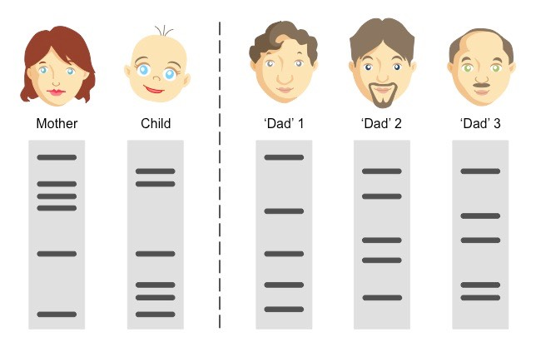
DNA profiling also used for paternity testing; here we are looking for a partial match that complements the match with the mother’s profile
Dad #3 is the father

Slide 17
MURDER MYSTERY
Definitions
Procedure
Reiterate learning objectives
questions

