Slide 1
Genetics – elementary school activity
DOMINIQUE BROOKS
STEPHEN RAMSEY

Slide 2
QUICK OVERVIEW
BACKGROUND
SPONGEBOB
ALIENS
DEBRIEF: REAL-WORLD APPLICATIONS

Slide 3
BACKGROUND
Mendelian inheritance:
For a trait, each individual organism has two alleles (diploid genome)
For each trait, each offspring receives one allele from each parent, chosen at random and independently of other traits (ignoring sex-linked traits)
Alleles are either dominant or recessive; for a given trait, having one dominant allele is sufficient to have the dominant phenotype.

Slide 4
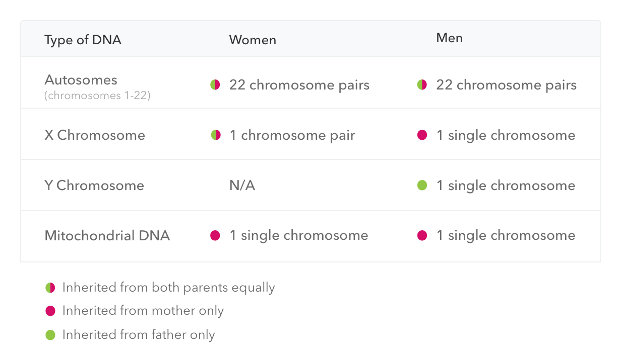
Summary of inheritance patterns for human chromosomes

Slide 5
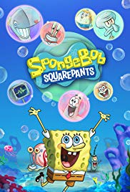
SPONGEBOB GENETICS
DEFINIFTIONS
PROCEDURE
REITERATE LEARNING OBJECTIVES
QUESTIONS?

Slide 6
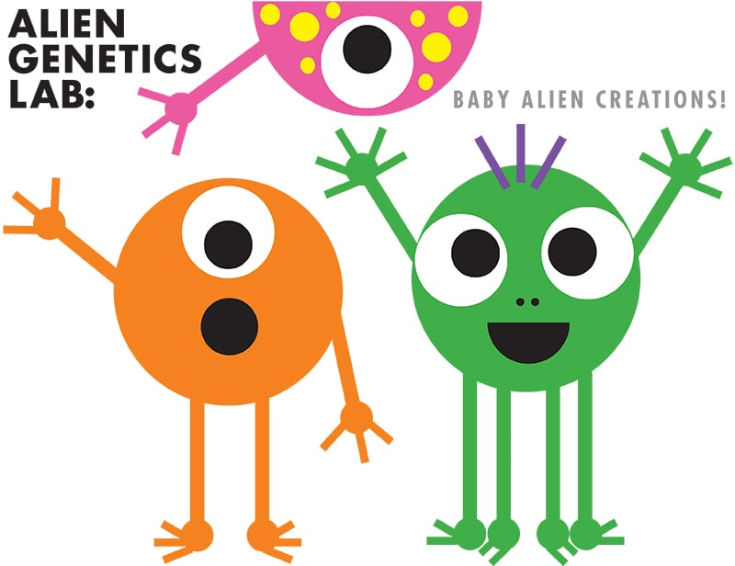
ALIEN BABY GENETICS
DEFINITIONS
PROCEDURE
SHARE OUT
REITERATE LEARNING OBJECTIVES
QUESTIONS?

Slide 7
Real-world applications by Stephen ramsey

