Slide 1
Genetics bingo
Dominique Brooks & Stephen Ramsey
Oregon State University
Notes:
Explain that some slides are included but not shown, so they are available to teachers as an additional resource for in-class use or just for additional reading.

Slide 2
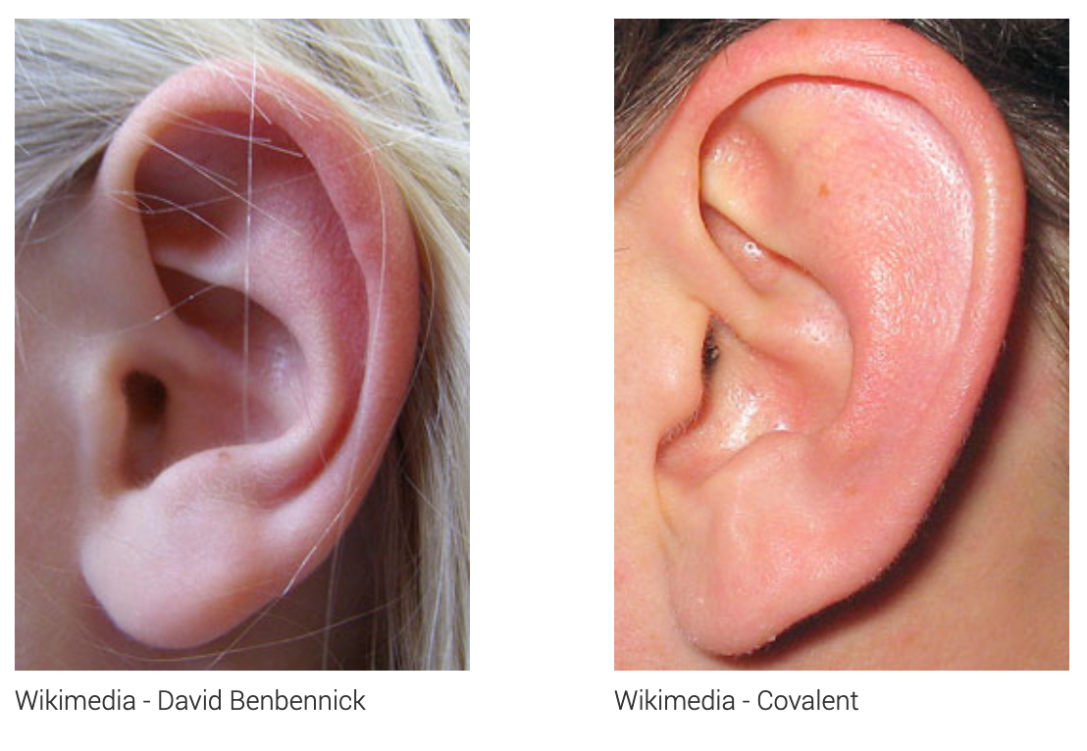
A trait is a measurable feature or behavior of an organism; it can have multiple phenotypes
“detached” earlobe
“attached” earlobe
Notes:
people sometimes say the “free” earlobe is a dominant phenotype
it’s probably a little bit inherited, but the genetics are complex; definitely not mendelian

Slide 3
Some traits are more discrete, others continuous
Discrete
Trait | Phenotypes
handedness | left-handed; right-handed; ambidextrous
tongue curling | roller; non-roller; partial roller
Continuous
Trait | Phenotypes
height | a measured height for a person
resting blood pressure | a measured resting blood pressure level for a person
Some traits are heritable (amount of heritability can vary by trait).
Genetics is the study of trait heritability.
Notes:
tongue curling: rolling was thought to be dominant

Slide 4
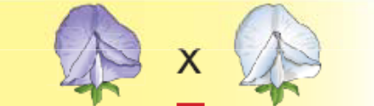
A trait with only two phenotypes is called “binary”
purple flower
white flower
most human traits are not binary, though

Slide 5
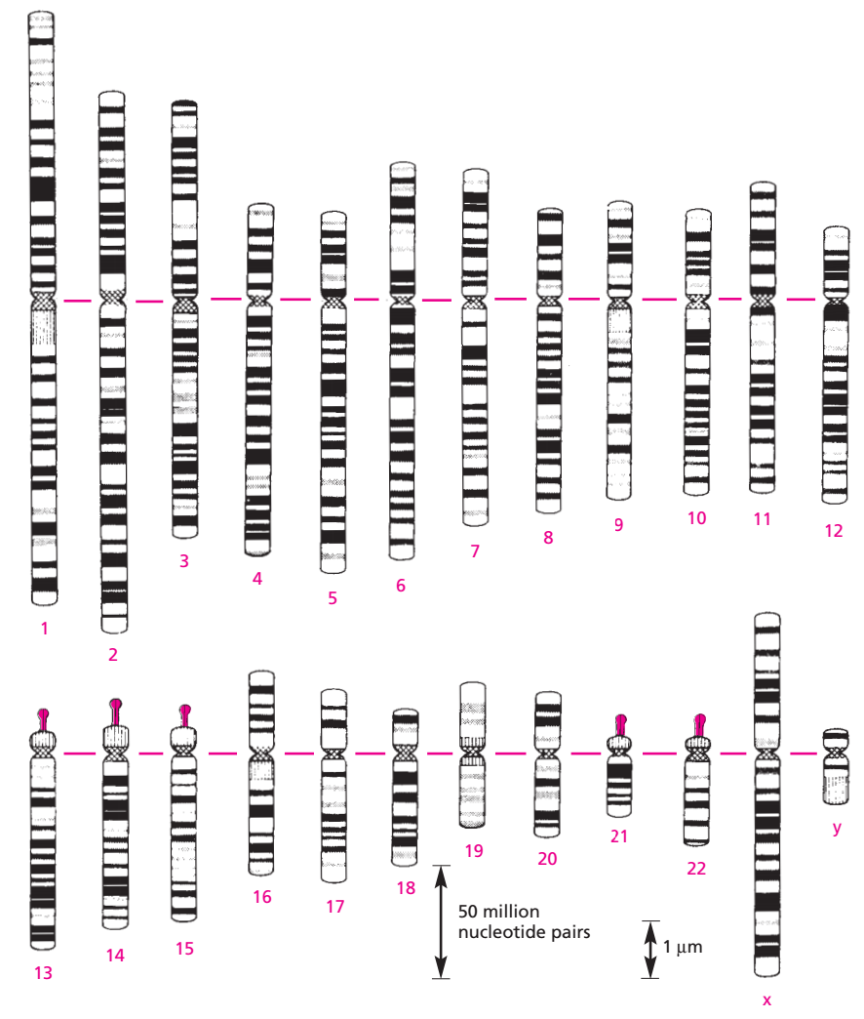
Human heredity comes via 23 pairs of chromosomes
we have two copies of each
numbered chromosome
Image credit: Molecular Biology of the Cell

Slide 6
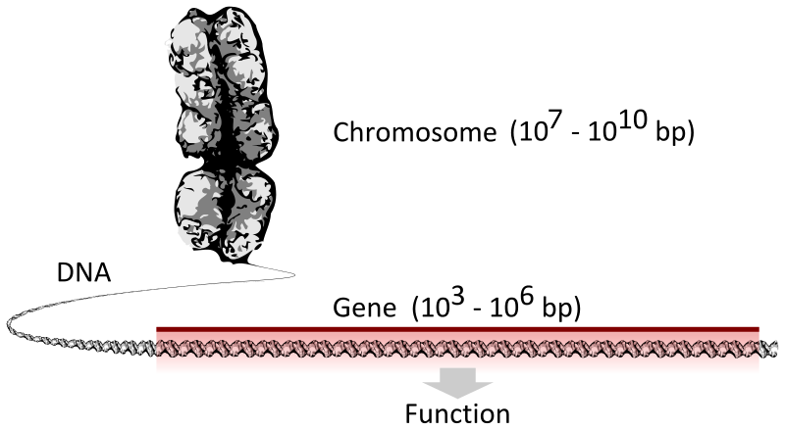
Within a chromosome, a gene encodes a functional protein or RNA
Image credit: Thomas Shafee

Slide 7
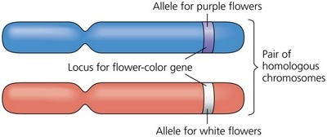
A particular "variant" (i.e., form) of a gene is called an allele
matched pair
of chromosomes
Image credit: slideshare.net

Slide 8
Alleles are often abbreviated
(P)
(p)
We call the combination of the two alleles, the person's genotype: Pp
Image credit: slideshare.net

Slide 9
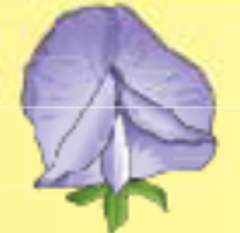
A "Mendelian" trait is a binary trait determined by the combination of two alleles of a single gene
(P)
(p)
Image credit: slideshare.net

Slide 10
For a Mendelian trait, one allele is dominant; the other is recessive
Pea plant flower trait:
"P" (purple) allele: dominant
"p" (white) allele: recessive
“dominant
phenotype”
“recessive
phenotype”
Pair of alleles | in English | Phenotype
PP | homozygous dominant | purple
Pp | heterozygous | purple
pp | homozygous rcessive | white
Notes:
note that ”genotype” as a concept is covered in one of the hidden slides
in this situation we would say that the dominant allele is the "purple" allele

Slide 11
Are these traits Mendelian (simple genetic inheritance)?
Trait | Binary? | Heritable? | Single gene (monogenic)? | Mendelian?
Pea plant flower color | yes | yes | yes | yes
thumb crossing (R/L) | yes (mostly) | probably partial | probably not | no
earlobe attachment (or not) | no (continuous) | possibly partial | no | no
cheek dimples | no (variably expressed; can change over time) | partial; irregular | probably not (chr 16?) | no
tongue rolling | no | partial | unknown | no
PTC tasting | no | partial | no (but TAS2R38 is the main gene) | no
Cleft chin | no (continuous) | partial | probably not | no
Freckles | no | partial | no (two genes) | no
Handedness | no (ambidextrous; can change over time) | partial | no (polygenic; at least 4 chromosomes) | no
Arm folding (R/L) | no | no | n/a | no
Eye color | no | yes | no; up to 16 genes | no
Notes:
tongue rolling: family studies indicate it is only partially inherited
PTC: family and twin studies show it is only partially inherited (tasting is the dominant allele)
cleft chin: people used to think the cleft chin is dominant; strong genetic influence but definitely not mendelian
handedness: 24% heritable

Slide 12
Discussing common human traits in a genetics curriculum
Avoid presenting traits with non-simple inheritance (e.g., cleft chin, earlobe attachment, tongue rolling, cheek dimples, etc.) as examples of “simple (classical Mendelian)” inheritance.
Consider: A student who has the dominant phenotype and both of whose parents have the recessive phenotype may jump to conclusions that are not warranted, and be confused or feel that something is wrong with them
Self-study of accurate genetic markers (such as blood type) as a classroom activity can also lead to discoveries by students that—while scientifically valid—are really not the kind of thing to be revealed in the classroom.
An alternative to using human traits to discuss classical Mendelian inheritance is to discuss the genetics of cat fur coloration, density, etc.
See the U. Delaware site: http://udel.edu/~mcdonald/mythintro.html

